Slide 1
COCONUT CROP HARVEST MECHANIZATION FOR REDUCING HARVEST CROP
PIP2001 Capstone Project
Review-3
Batch Number:
Roll Number | Student Name
20211ISR0017 | P L THIYAGARAJAN
20211ISR0034 | MADHUBALA S
20211ISR0011 | ADITYA M SUDAN
20211ISR0028 | MERVYN CHRISTY J
20211ISR0045 | B KRIPASHINI
Under the Supervision of,
Dr. AKSHATHA Y
Professor / Associate Professor / Assistant Professor
School of Computer Science and Engineering
Presidency University
Name of the Program: B.TECH
Name of the HoD: Dr. ZAFAR ALI KHAN
Name of the Program Project Coordinator: Dr. AFROZ PASHA
Name of the School Project Coordinators: Dr. Sampath A K / Dr. Abdul Khadar A / Mr. Md Ziaur Rahman

Slide 2
Introduction
In tropical areas, coconut cultivation is essential, but conventional harvesting techniques are dangerous, time-consuming, and labor-intensive. These practices also result in greater agricultural losses and inefficiencies like collecting immature coconuts.
Mechanization provides a possible answer to these problems. The goal of this project is to create a mechanical coconut harvesting system with a robotic arm equipped with cutting and grasping mechanisms that employ an Arduino-based control unit. The technology ensures accurate and effective harvesting while reducing crop losses by identifying ripe coconuts using sophisticated sensors including ultrasonic detectors and image recognition.
Both small-scale farmers and huge plantations may benefit from the system's scalable architecture and integration of IoT technology for real-time performance monitoring. Farmers benefit from increased production, lower labor costs, increased worker safety, and more precise harvesting thanks to automation of the harvesting process.
Through waste reduction and the encouragement of renewable energy sources like solar power, the system also encourages sustainability.

Slide 3
Literature Review
Coconut crop harvest mechanization has become increasingly important in enhancing the efficiency of coconut production, particularly in reducing labor costs and minimizing crop loss. Traditional harvesting methods are labor-intensive, which poses challenges in terms of efficiency and labor shortages. Various mechanization technologies have been developed, including mechanical harvesters that range from simple hand-held devices to advanced machines capable of climbing trees. Innovations in robotics and automation have also emerged, featuring automated systems such as drones for monitoring coconut growth and robots equipped with sensors for detecting and harvesting ripe coconuts. Post-harvest processing equipment further streamlines operations, with machines for husking, shelling, drying, and packaging coconuts.
The impact of mechanization on crop yield and labor is significant. Studies indicate that mechanization can lead to higher crop yields by reducing the time between harvesting and processing, which helps maintain quality and minimizes damage to the coconuts. Furthermore, mechanization reduces the dependency on manual labor, addressing labor shortages faced by the coconut industry, and ultimately leading to long-term savings despite high initial investment costs. Additionally, mechanized harvesting enhances worker safety by reducing the risk of injury associated with manual climbing and harvesting, thus improving overall working conditions.
However, challenges remain, such as the high upfront costs of machinery, which can be a barrier for smallholder farmers, and the need for technical expertise in maintenance and operation, which may not be readily available in rural areas. Furthermore, not all mechanization technologies are suitable for every coconut farming environment, requiring careful consideration of local conditions. Continued research and development of cost-effective and adaptable mechanization solutions are essential for the coconut industry’s future. Stakeholders, including governments and agricultural organizations, should prioritize investment in training programs and subsidies to facilitate the adoption of these technologies among small farmers, ultimately leading to a more sustainable and efficient coconut production system.

Slide 4
Existing method Drawback
Labor-Intensive Process: Traditional methods of coconut harvesting rely heavily on manual labor.
Safety Risks: Climbing coconut trees, which can reach heights of 20-30 meters, is inherently dangerous.
Inefficiency and Time Consumption: Manual harvesting is slow, as each tree must be climbed one at a time.
High Labor Costs: The reliance on manual labor also increases operational costs. As wages for skilled workers rise, farmers face growing expenses, which reduce profit margins.
Inconsistent Harvesting: Human errors or fatigue can result in inconsistent harvesting practices, where some coconuts are left behind or harvested at different stages of ripeness. This inconsistency affects the overall yield quality and can reduce market value.

Slide 5
Proposed Method
Automated Climbing and Harvesting Robots: One of the key proposals is to develop robotic systems capable of climbing coconut trees and harvesting coconuts automatically. These robots could be equipped with:
Climbing mechanisms
Cutting tools
Sensors and cameras
Arduino-Based Control Systems for Smart Harvesting: Arduino or similar microcontroller platforms can be used to automate various aspects of the harvesting system. Possible implementations include:
Automated timing and precision
Integration of sensors
Integrated System with IoT (Internet of Things):
By integrating IoT technology, real-time data can be collected and used to monitor the health and maturity of coconut trees. The system could:
Provide farmers with remote access
Automatically trigger harvesting processes

Slide 6
Objectives
Reduce Manual Labor in Harvesting: The primary objective is to minimize the reliance on manual labor by introducing mechanized or automated systems.
Enhance Harvest Efficiency and Speed: By implementing mechanized systems such as robots, drones, or motorized tools, the project aims to increase the speed and efficiency of the harvesting process.
Cost Reduction and Profitability: Another important objective is to lower the overall cost of harvesting by reducing the dependency on labor and Improving operational efficiency.
Integrate Modern Technology for Smart Farming: By incorporating Arduino-based control systems, IoT technology, and sensors, the project aims to create a smart harvesting system that can be remotely controlled, monitored, and automated for optimal performance and ease of use.
Reduce Worker Fatigue:
By minimizing manual labor, the project helps reduce worker exhaustion, leading to better productivity in other farming activities.

Slide 7
Methodology/Modules
Literature Review and Needs Assessment
Objective:
Understand existing harvesting methods and identify the specific needs and challenges of coconut farmers.
Activities:
Review scholarly articles, case studies, and reports on coconut harvesting and agricultural mechanization
System Design and Development
Objective:
Design a mechanized harvesting system tailored to the specific requirements of coconut farming.
Activities:
Conceptual Design: Create initial sketches and design blueprints for proposed harvesting technologies (e.g., robotic harvesters, drones).
Testing and Prototyping
Objective:
Validate the design and functionality of the harvesting system in real-world conditions.
Activities:
Conduct field tests on selected coconut farms to evaluate system performance.
Data Collection and Analysis
Objective: Collect and analyze data from testing to optimize the system.
Activities:
Use sensors and IoT devices to gather real-time data on crop health, ripeness, and harvesting efficiency.

Slide 8
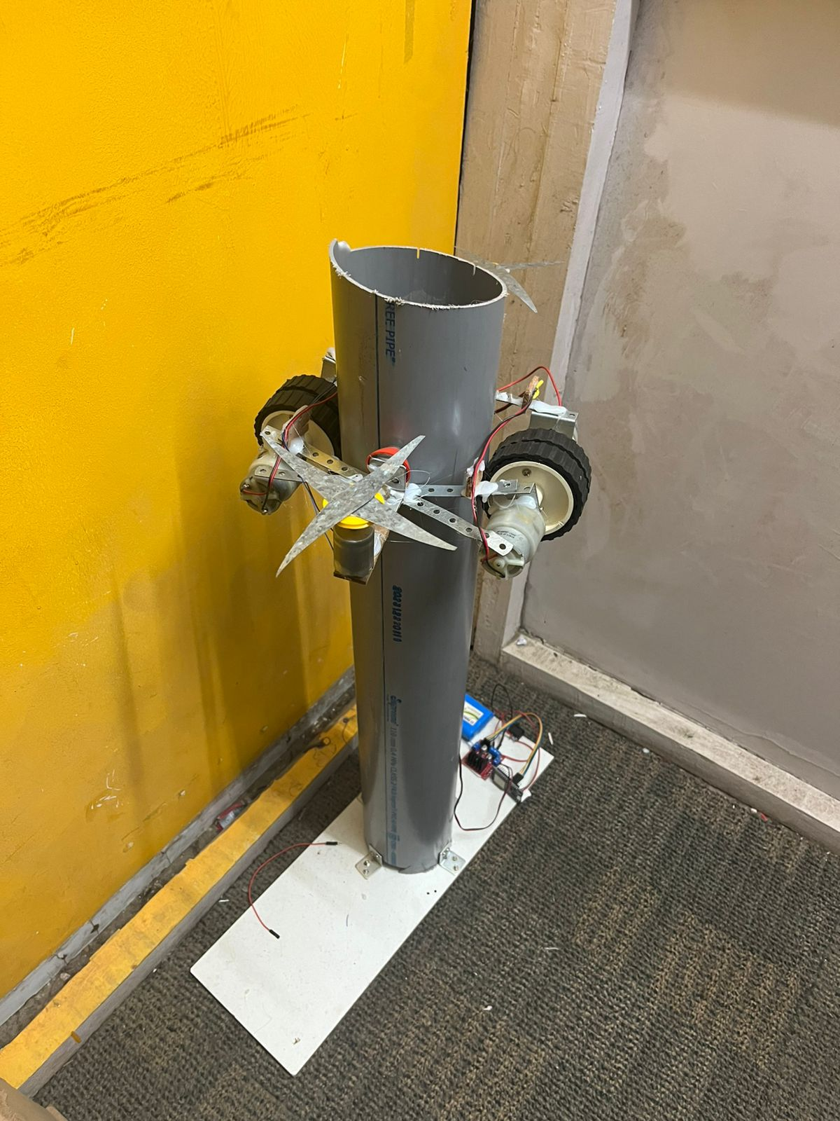
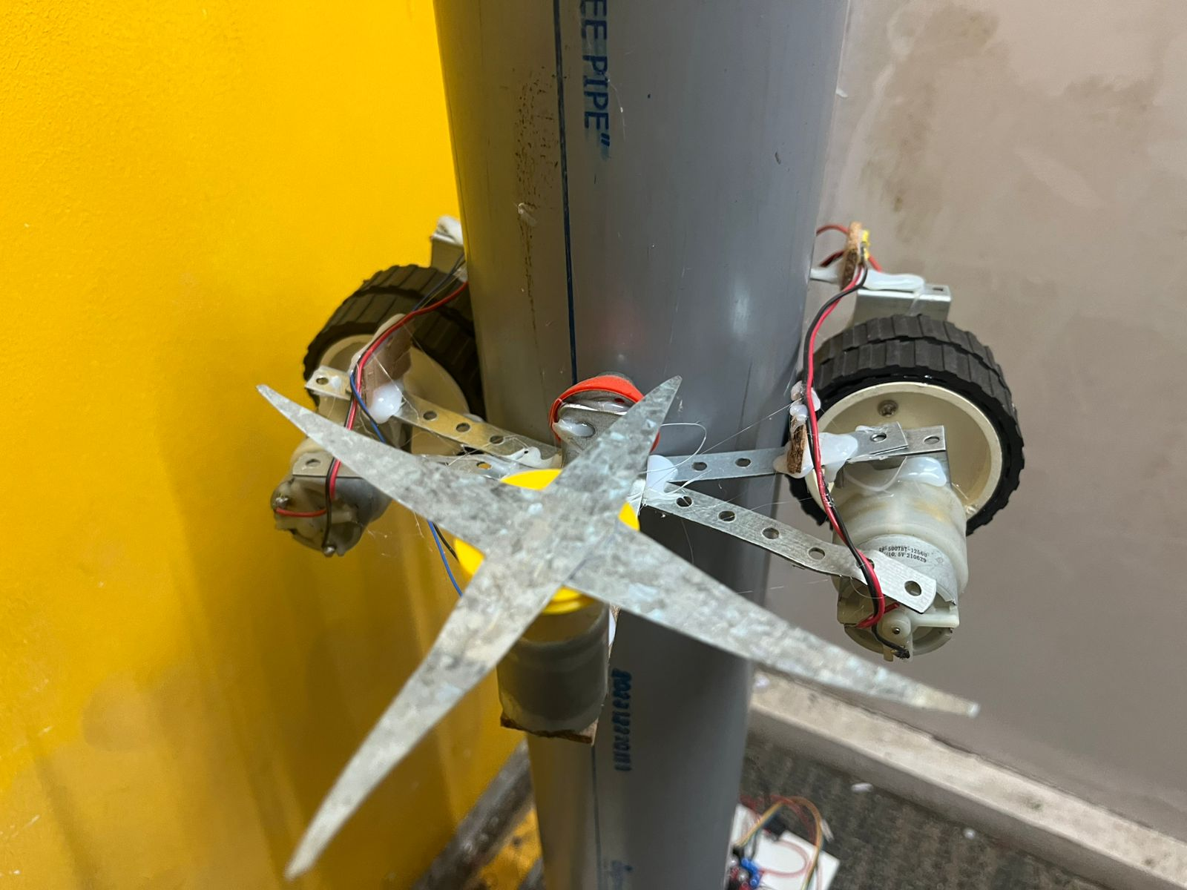
Architecture

Slide 9
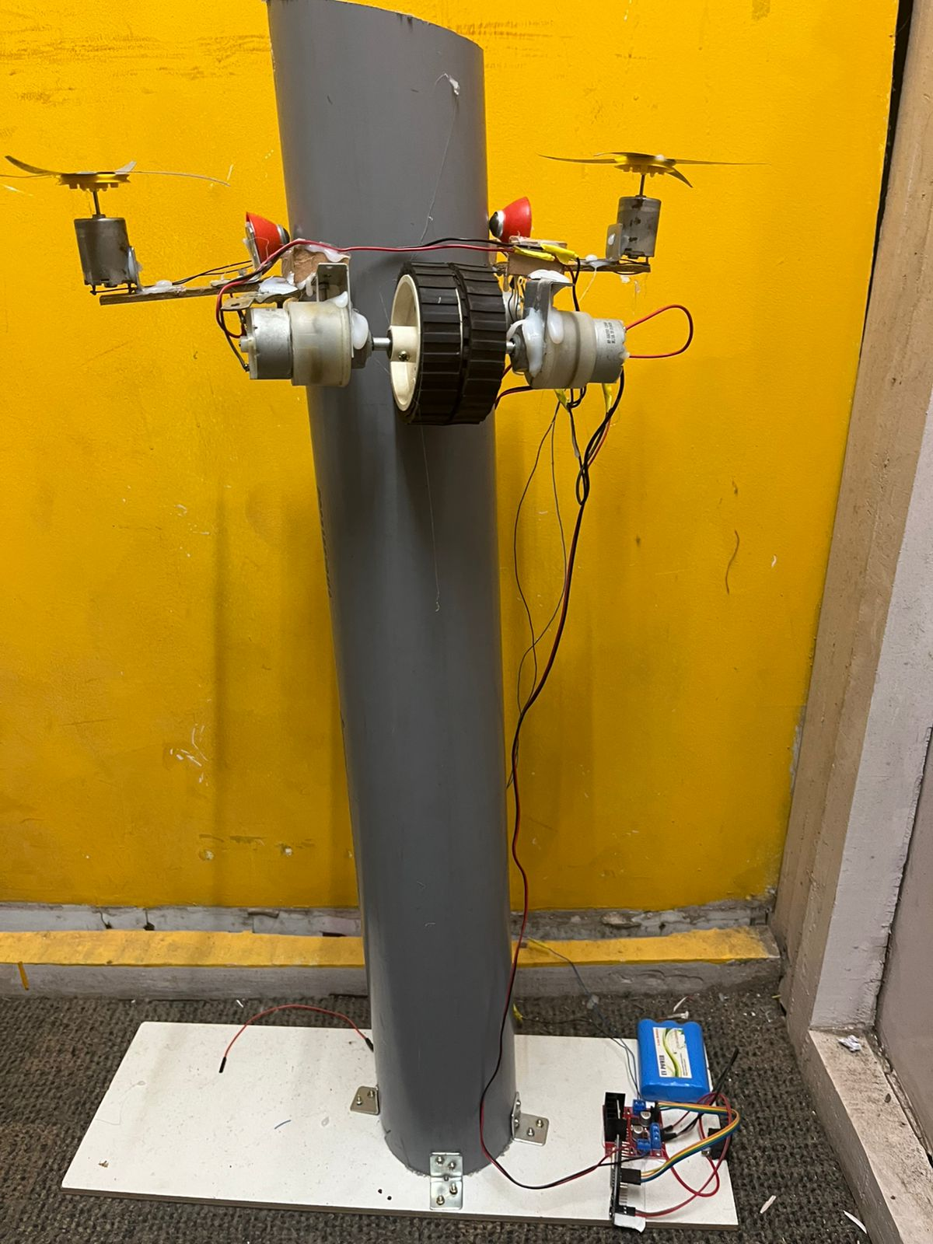
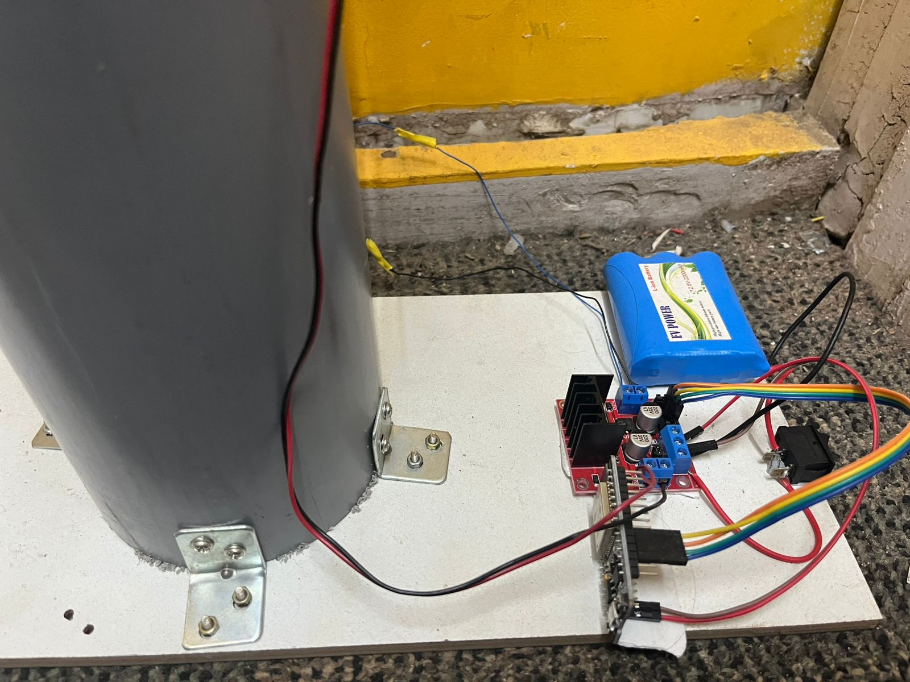

Slide 10
COMPONENTS
For smooth functioning, the Internet of Things-based coconut harvester combines essential hardware and software elements:
Hardware:
The ESP32 microcontroller is a central device that may be controlled remotely thanks to its Wi-Fi connection.
Motors:
Activated by GPIO pins, these devices regulate movement both upward and downward.
Cutter Mechanism:
ESP32-controlled precise cutting mechanism.
Power Supply:
Gives components steady power.
Program:
Commands are sent to the ESP32 using the Blynk App, a remote control interface.
C/C++ code that interprets app inputs and initiates motor/cutter operations is known as embedded programming.

Slide 11
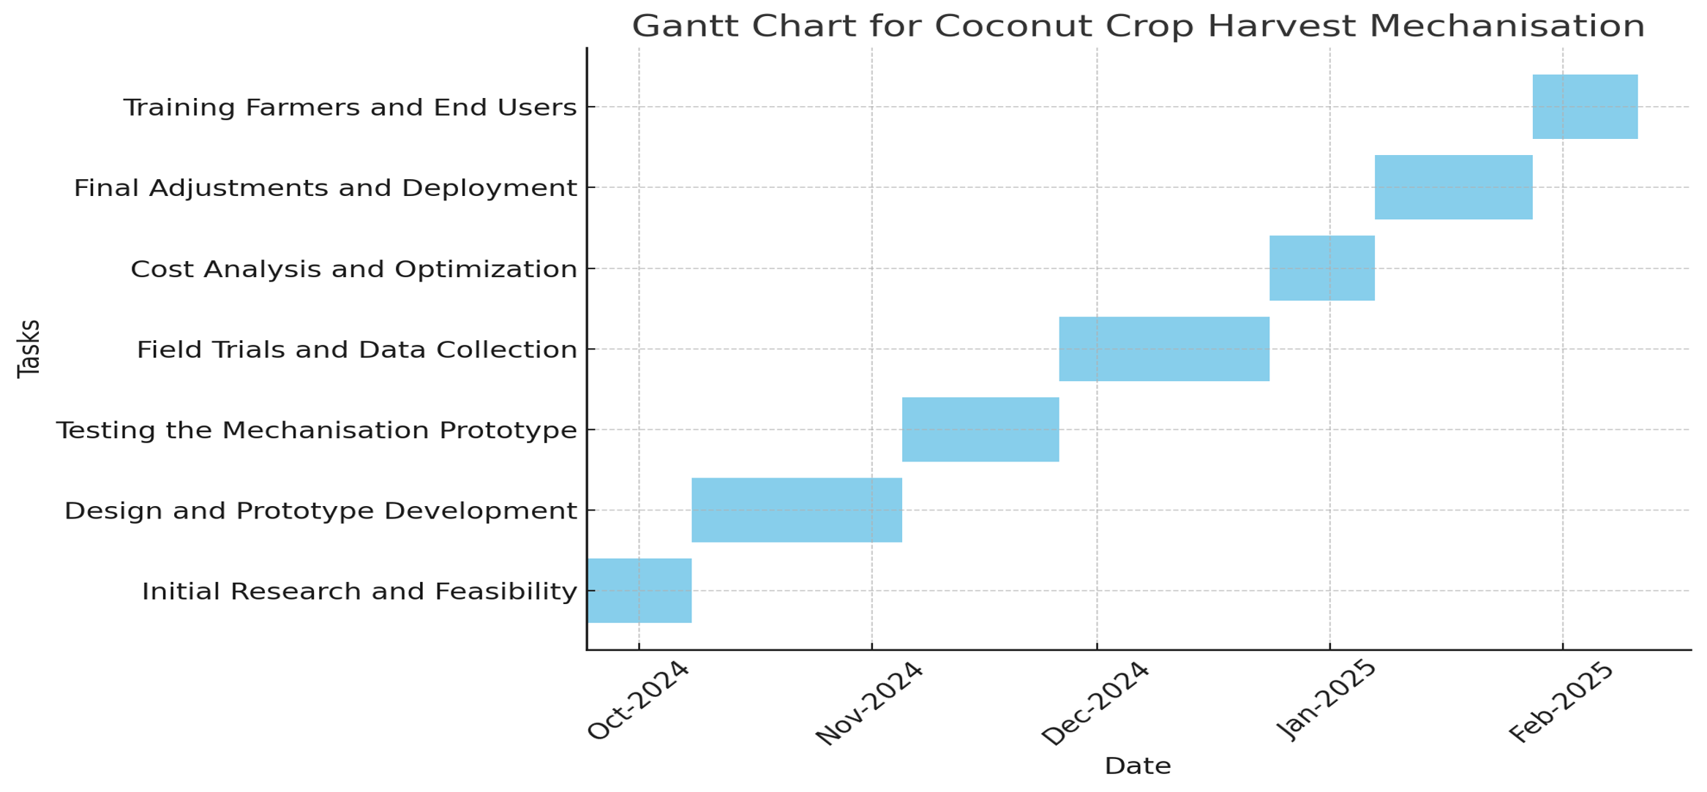
Timeline of Project

Slide 12
Expected Outcomes
Increased Harvest Efficiency:
The mechanization of coconut harvesting is expected to significantly improve the speed
and efficiency of the harvesting process.
Reduced Labor Dependency: By introducing automated systems, the project aims to decrease reliance on manual labor, addressing challenges related to labor shortages and seasonal workforce fluctuations.
Minimized Post-Harvest Losses: With more precise and timely harvesting, the project is expected to lower post-harvest losses due to overripe or damaged coconuts, ultimately improving the overall quality and yield of the crop.
Cost Savings: The implementation of mechanized harvesting is anticipated to lower operational costs by reducing labor expenses and increasing productivity, leading to improved profit margins for farmers.
Economic Growth in Coconut Farming Regions: By improving the efficiency and profitability of coconut harvesting, the project aims to contribute to economic growth in regions that heavily depend on coconut agriculture, enhancing the livelihoods of local farmers.

Slide 13
Conclusion
Using contemporary IoT technology, the coconut crop harvesting system effectively showcased its capacity to automate the harvesting process. A dependable and intuitive remote operating solution was made possible by the ESP32 microcontroller's combination with DC motors and the Blynk platform. By eliminating the need for physical work in potentially dangerous situations, the technology increased operational safety.]
The quick control through the Blynk app and the seamless coordination between the motorized components demonstrated the system's usefulness and efficiency. The system might be enhanced for commercial agricultural usage with additional improvements, such the use of renewable power sources and sensors for increased accuracy. All things considered, the endeavor is a big step toward safer and more effective coconut harvesting techniques, helping to develop

Slide 14
Github Link
The Github link provided should have public access permission.
Github Link
https://github.com/Thiyag15/C-0-CONUT-harVESTER

Slide 15
References
https://www.ijareeie.com/upload/2019/april/3_Autonomous.pdf?utm_source=chatgpt.com
https://www.rroij.com/open-access/design-and-fabrication-of-coconut-harvestingrobot-cocobot.pdf?utm_source=chatgpt.com
https://www.researchgate.net/publication/319473935_A_Survey_on_Robotic_Coconut_Tree_Climbers_-_Existing_Methods_and_Techniques?utm_source=chatgpt.com
https://www.researchgate.net/publication/343456771_Amaran_An_Unmanned_Robotic_Coconut_Tree_Climber_and_Harvester?utm_source=chatgpt.com
https://www.researchgate.net/publication/369825823_Status_and_Scope_of_Automated_Coconut_Harvester_in_India_A_Review

Slide 16
Thank You

